Slide 1


Let’s Talk -
Safe Infant Sleep
A Class for Parents and Caregivers
Notes:
Image credit: Texas DSHS

Slide 2

Introductions
Please Share:
Notes:
Image credit: Texas DSHS

Slide 3
Class Objectives
Learn actions you can take to keep your baby safe during sleep
Spot myths about infant sleep
Create a safe sleep plan to share with others who may care for your baby
Identify people or groups in your community who can help you stick to your safe sleep plan

Slide 4

What Do We Know About Safe Infant Sleep?
What Will We Learn?
Notes:
Image credit: Texas DSHS

Slide 5
Sleep-Related Infant Deaths
Every year, approximately 3,500 infants die in the United States due to sleep-related death.
Sudden infant death syndrome (SIDS), unknown or unexplained cause, and accidental suffocation and strangulation in bed were the second, third, and fourth most common causes of overall infant death (AAP, 2022).
86% of sleep-related deaths occurred in the first five months of life (NCFRP, 2021).
SIDS is the fourth most common cause of death for infants under one year in Texas.
Notes:
Every year, approximately 3,500 infants die in the United States due to sleep-related death.
Sudden infant death syndrome (SIDS), unknown or unexplained cause, and accidental suffocation and strangulation in bed were the second, third, and fourth most common causes of overall infant death (AAP, 2022).
86% of sleep-related deaths occurred in the first 5 months of life (CFRP, 2021).
SIDS is the 4th most common cause of death for infants under 1 year in Texas.
You may be wondering why are we sharing this data. We want to recognize that there are many parents, caregivers, and infants that represent the data on the screen and their personal stories are important to remember. We are sharing what we know today about sleep-related infant deaths- and want to encourage you to know that there are actionable steps that you can take to help change these outcomes.
We understand that this information can be hard to hear or think about. If you find the information shared in this slide or this topic in general upsetting to you, or if it triggers feelings that you find difficult to manage, do not be afraid to leave the room, or ask for support should you need to.
Reference:
Rachel Y. Moon, Rebecca F. Carlin, Ivan Hand, THE TASK FORCE ON SUDDEN INFANT DEATH SYNDROME and THE COMMITTEE ON FETUS AND NEWBORN; Evidence Base for 2022 Updated Recommendations for a Safe Infant Sleeping Environment to Reduce the Risk of Sleep-Related Infant Deaths. Pediatrics July 2022; 150 (1): e2022057991. 10.1542/peds.2022-057991
Sleep-Related Infant Deaths – The National Center for Fatality Review and Prevention (ncfrp.org)
2021 Healthy Texas Mothers and Babies Data Book
Image credit: Texas DSHS

Slide 6
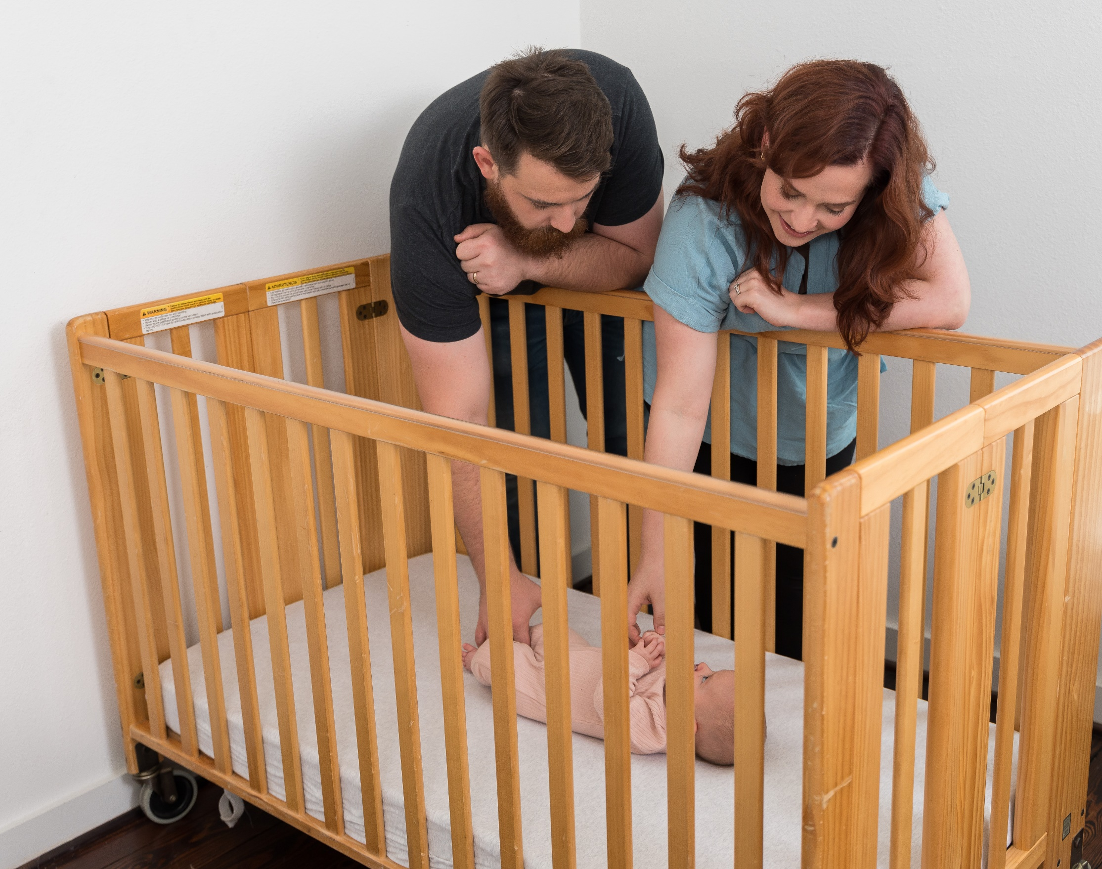
Let’s Review
Definitions
What is normal?
Myths and Facts Game
Notes:
Image credit: Texas DSHS

Slide 7
Definitions to Remember
Room Sharing | When your baby sleeps in your room or the same room as other adult caregivers on a separate sleep surface (crib, bassinet, or play yard). Room-sharing can lower your baby’s risk of SIDS and supports breastfeeding.
Bed Sharing | When your baby shares a sleep surface (adult bed, sofa, recliner, or other surface used for sleep) with a parent, other child, and/or another adult caretaker.
Tummy Time | Placing your baby on their tummy on the floor while baby is awake. A baby should never be left alone, especially during tummy time.
Notes:
Room Sharing: When baby sleeps in the same room as a parents, other adults, caregivers or children, but on a separate sleep surface (crib, bassinet, or play yard). Room sharing is known to reduce the risk of SIDS and supports continued exclusive breastfeeding.
Bed Sharing: When baby shares a sleep surface (adult bed, sofa, recliner, or other surface used for sleep) with a parent, other child, and/or another adult caretaker.
Tummy time: Placing your baby on his or her tummy on the floor while he or she is awake. A baby should never be left unattended, especially during tummy time.
Reference:
Rachel Y. Moon, Rebecca F. Carlin, Ivan Hand, THE TASK FORCE ON SUDDEN INFANT DEATH SYNDROME and THE COMMITTEE ON FETUS AND NEWBORN; Evidence Base for 2022 Updated Recommendations for a Safe Infant Sleeping Environment to Reduce the Risk of Sleep-Related Infant Deaths. Pediatrics July 2022; 150 (1): e2022057991. 10.1542/peds.2022-057991

Slide 8
Quiz Time!
Myth vs. fact quiz questions
Check your knowledge
Find out what we don’t know
Notes:
Points to Cover:
There are many myths about safe sleep and unexpected infant death (SUID).
This section will clarify true and false statements about safe sleep practices and the unexpected death of an infant.
Participants can follow along with their Myth or Fact handout.
Information for the instructor:
Knowledge Pre-check Quiz:
In this section, you will want the class to talk about true and false statements about safe sleep and sudden unexpected infant death (SUID). The class will have a handout that they can go through individually and mark if they think the statements are true or false.
When going through each one of these items be sure to allow the class time to discuss what they’ve been told, or what they’ve heard; especially if what they’ve heard is contrary to what you are telling them.
Activity instructions: I’m going to read a statement, and I want you to say if it is a FACT or a MYTH

Slide 9
Myth or Fact
Question 1
If your baby is placed on his back to sleep instead of his stomach, he will be more likely to choke.

Slide 10
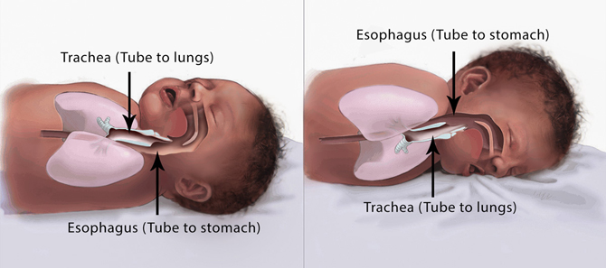
Myth
Healthy babies tend to automatically swallow or cough up fluids when they are lying on their backs. They also have other ways, such as a gag reflex, to prevent choking while lying on their backs.
Notes:
Healthy babies tend to swallow or cough up fluids best when they are lying on their backs. They also have a gag reflex to help prevent choking while lying on their backs.
Resource from American Academy of Pediatrics (AAP):
Placing a baby in the back to sleep (supine sleep position) on a firm, flat, non-inclined surface does not increase the risk of choking and aspiration in infants and is recommended for every sleep, even for infants with gastroesophageal reflux "reflux".
Parents and caregivers continue to be concerned that an infant will choke or aspirate while supine.^{149–157} Parents often misconstrue coughing or gagging, which is evidence of a normal protective gag reflex, for choking or aspiration. Multiple studies in different countries have not demonstrated an increased incidence of aspiration since the change to supine sleeping.^{172–174} Parents and caregivers are often concerned about aspiration when the infant has been diagnosed with gastroesophageal reflux (GER). The AAP concurs with the North American Society for Pediatric Gastroenterology and Nutrition that “…no position other than supine position is recommended for infants because of the risk of sudden infant death syndrome (SIDS).”¹⁷⁵ Further, “the working group recommends not to use positional therapy (ie, head elevation, lateral and prone positioning) to treat symptoms of GERD (gastroesophageal reflux disease) in sleeping infants.”¹⁷⁵
Reference:
Rachel Y. Moon, Rebecca F. Carlin, Ivan Hand, THE TASK FORCE ON SUDDEN INFANT DEATH SYNDROME and THE COMMITTEE ON FETUS AND NEWBORN; Evidence Base for 2022 Updated Recommendations for a Safe Infant Sleeping Environment to Reduce the Risk of Sleep-Related Infant Deaths. Pediatrics July 2022; 150 (1): e2022057991. 10.1542/peds.2022-057991
Image Credit: Image courtesy of the Safe to Sleep® campaign, for educational purposes only; Eunice Kennedy Shriver National Institute of Child Health and Human Development, http://www.nichd.nih.gov/sids; Safe to Sleep® is a registered trademark of the U.S. Department of Health and Human Services.

Slide 11
Question 2
Myth or Fact
There are things I can do to reduce my baby’s risk of sleep-related death.

Slide 12
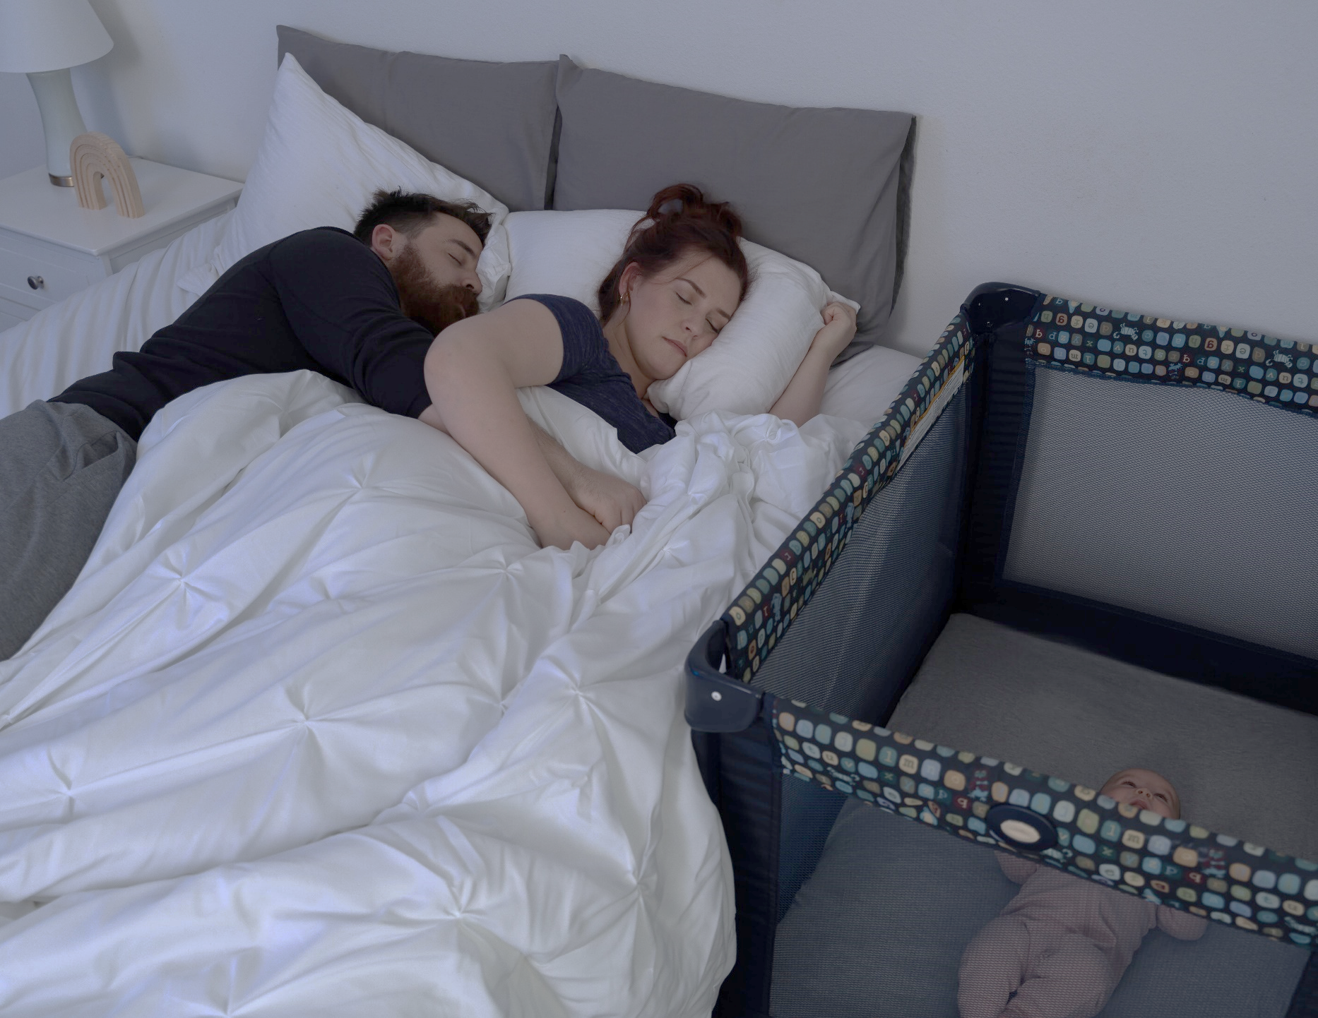
Fact
There are many things you can do to reduce your infant’s risk of sleep-related death.
Notes:
There are many steps you and those caring for your baby can take to reduce your infant’s risk of sleep-related death. This class includes safe sleep practices on the most updated evidence shared in 2022 by the American Academy of Pediatrics
Reference:
Moon RY, Carlin RF, Hand I; AAP Task Force on Sudden Infant Death Syndrome; AAP Committee on Fetus and Newborn. Sleep-Related Infant Deaths: Updated 2022 Recommendations for Reducing Infant Deaths in the Sleep Environment. Pediatrics. 2022;150(1):e2022057990
Image credit: Texas DSHS

Slide 13
Question 3
Myth or Fact
Immunizations can cause SIDS or the unexpected death of an infant.

Slide 14
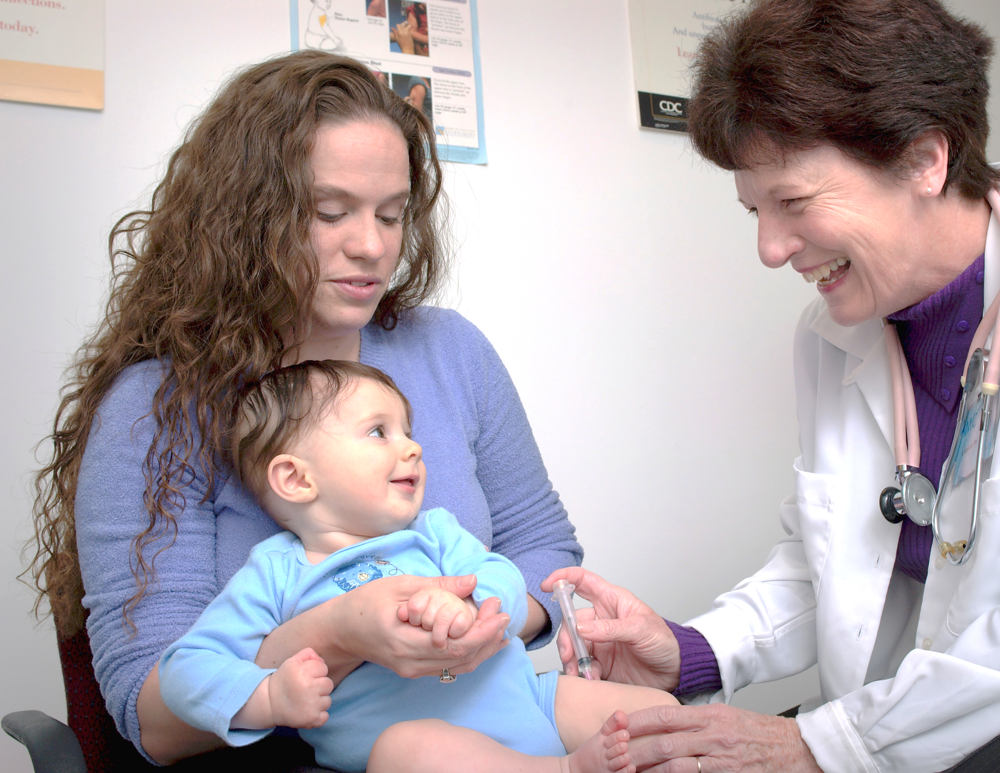
Myth
There is no evidence that immunizations cause SIDS or the unexpected death of an infant.
Notes:
There is no evidence that immunizations cause SIDS or the unexpected death of an infant.
The 2022 AAP report on evidence continues to show no causal relationship between immunizations and SIDS and suggests that vaccination may have a protective effect against SIDS.
Suggested handout resource: 2023 Recommended Immunizations for Children from Birth Through 6 Years Old (cdc.gov)
Reference:
Moon RY, Carlin RF, Hand I; AAP Task Force on Sudden Infant Death Syndrome; AAP Committee on Fetus and Newborn. Sleep-Related Infant Deaths: Updated 2022 Recommendations for Reducing Infant Deaths in the Sleep Environment. Pediatrics. 2022;150(1):e2022057990
Image source: Photo by CDC on Unsplash

Slide 15
Question 4
Myth or Fact
It takes time for your baby to learn to sleep soundly on his or her back.

Slide 16
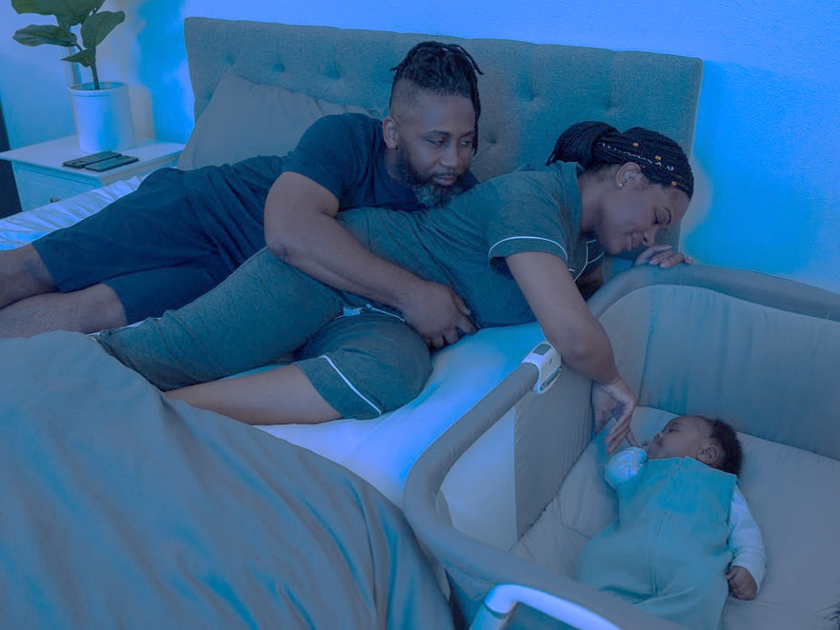
Fact
Sleeping soundly on the back is learned and parents shouldn’t give up. If your baby wakes during the night, remember that lighter sleep protects baby against unexpected death.
Notes:
Sleeping soundly on their back is something your baby will learn and you shouldn’t give up. If your baby wakes up during the night, remember that lighter sleep and waking more often helps protect your baby against SIDS.
Resource from AAP:
One reason often cited by parents for not using the supine sleep position is the perception that the infant is uncomfortable or does not sleep well.^{149–157} However, an infant who wakes frequently is typical and should not be perceived as a poor sleeper. Physiologic studies demonstrate that infants are less likely to arouse when they are sleeping in the prone position.^{158–166} The ability to arouse from sleep is an important protective physiologic response to stressors during sleep,^{167–171} and the infant’s ability to sleep for sustained periods may not be physiologically advantageous.
Reference:
Moon RY, Carlin RF, Hand I; AAP Task Force on Sudden Infant Death Syndrome; AAP Committee on Fetus and Newborn. Sleep-Related Infant Deaths: Updated 2022 Recommendations for Reducing Infant Deaths in the Sleep Environment. Pediatrics. 2022;150(1):e2022057990
Image credit: Texas DSHS

Slide 17
Question 5
Putting my baby on his or her back will lead to a flat head.
Myth or Fact

Slide 18

Myth
Putting your baby to sleep on his or her back does not lead to a flat head. However, if your baby is always left on their back, for example, in the car seat, in a swing chair, or in a stroller, it could lead to a flattening of the head. Therefore, tummy time is important!
Notes:
Putting your baby to sleep on his or her back does not lead to a flat head. If your baby is always left on his or her back while sleeping in a car seat swing chair, or a stroller, it could lead to flattening of their head. To prevent this, it is important to add supervised tummy time every day!
Parents and caregivers should provide their baby with tummy time 2-3 times a day for short periods beginning soon after hospital discharge, increasing incrementally to at least 15 to 30 minutes total daily by 7 weeks of age. This should happen when the baby is awake, and always be supervised so they can watch the baby closely.
Reference:
Moon RY, Carlin RF, Hand I; AAP Task Force on Sudden Infant Death Syndrome; AAP Committee on Fetus and Newborn. Sleep-Related Infant Deaths: Updated 2022 Recommendations for Reducing Infant Deaths in the Sleep Environment. Pediatrics. 2022;150(1):e2022057990
Image credit: Texas DSHS

Slide 19
Question 6
Myth or Fact
Smoking anywhere near your baby can increase the risk of sudden unexpected infant death.

Slide 20
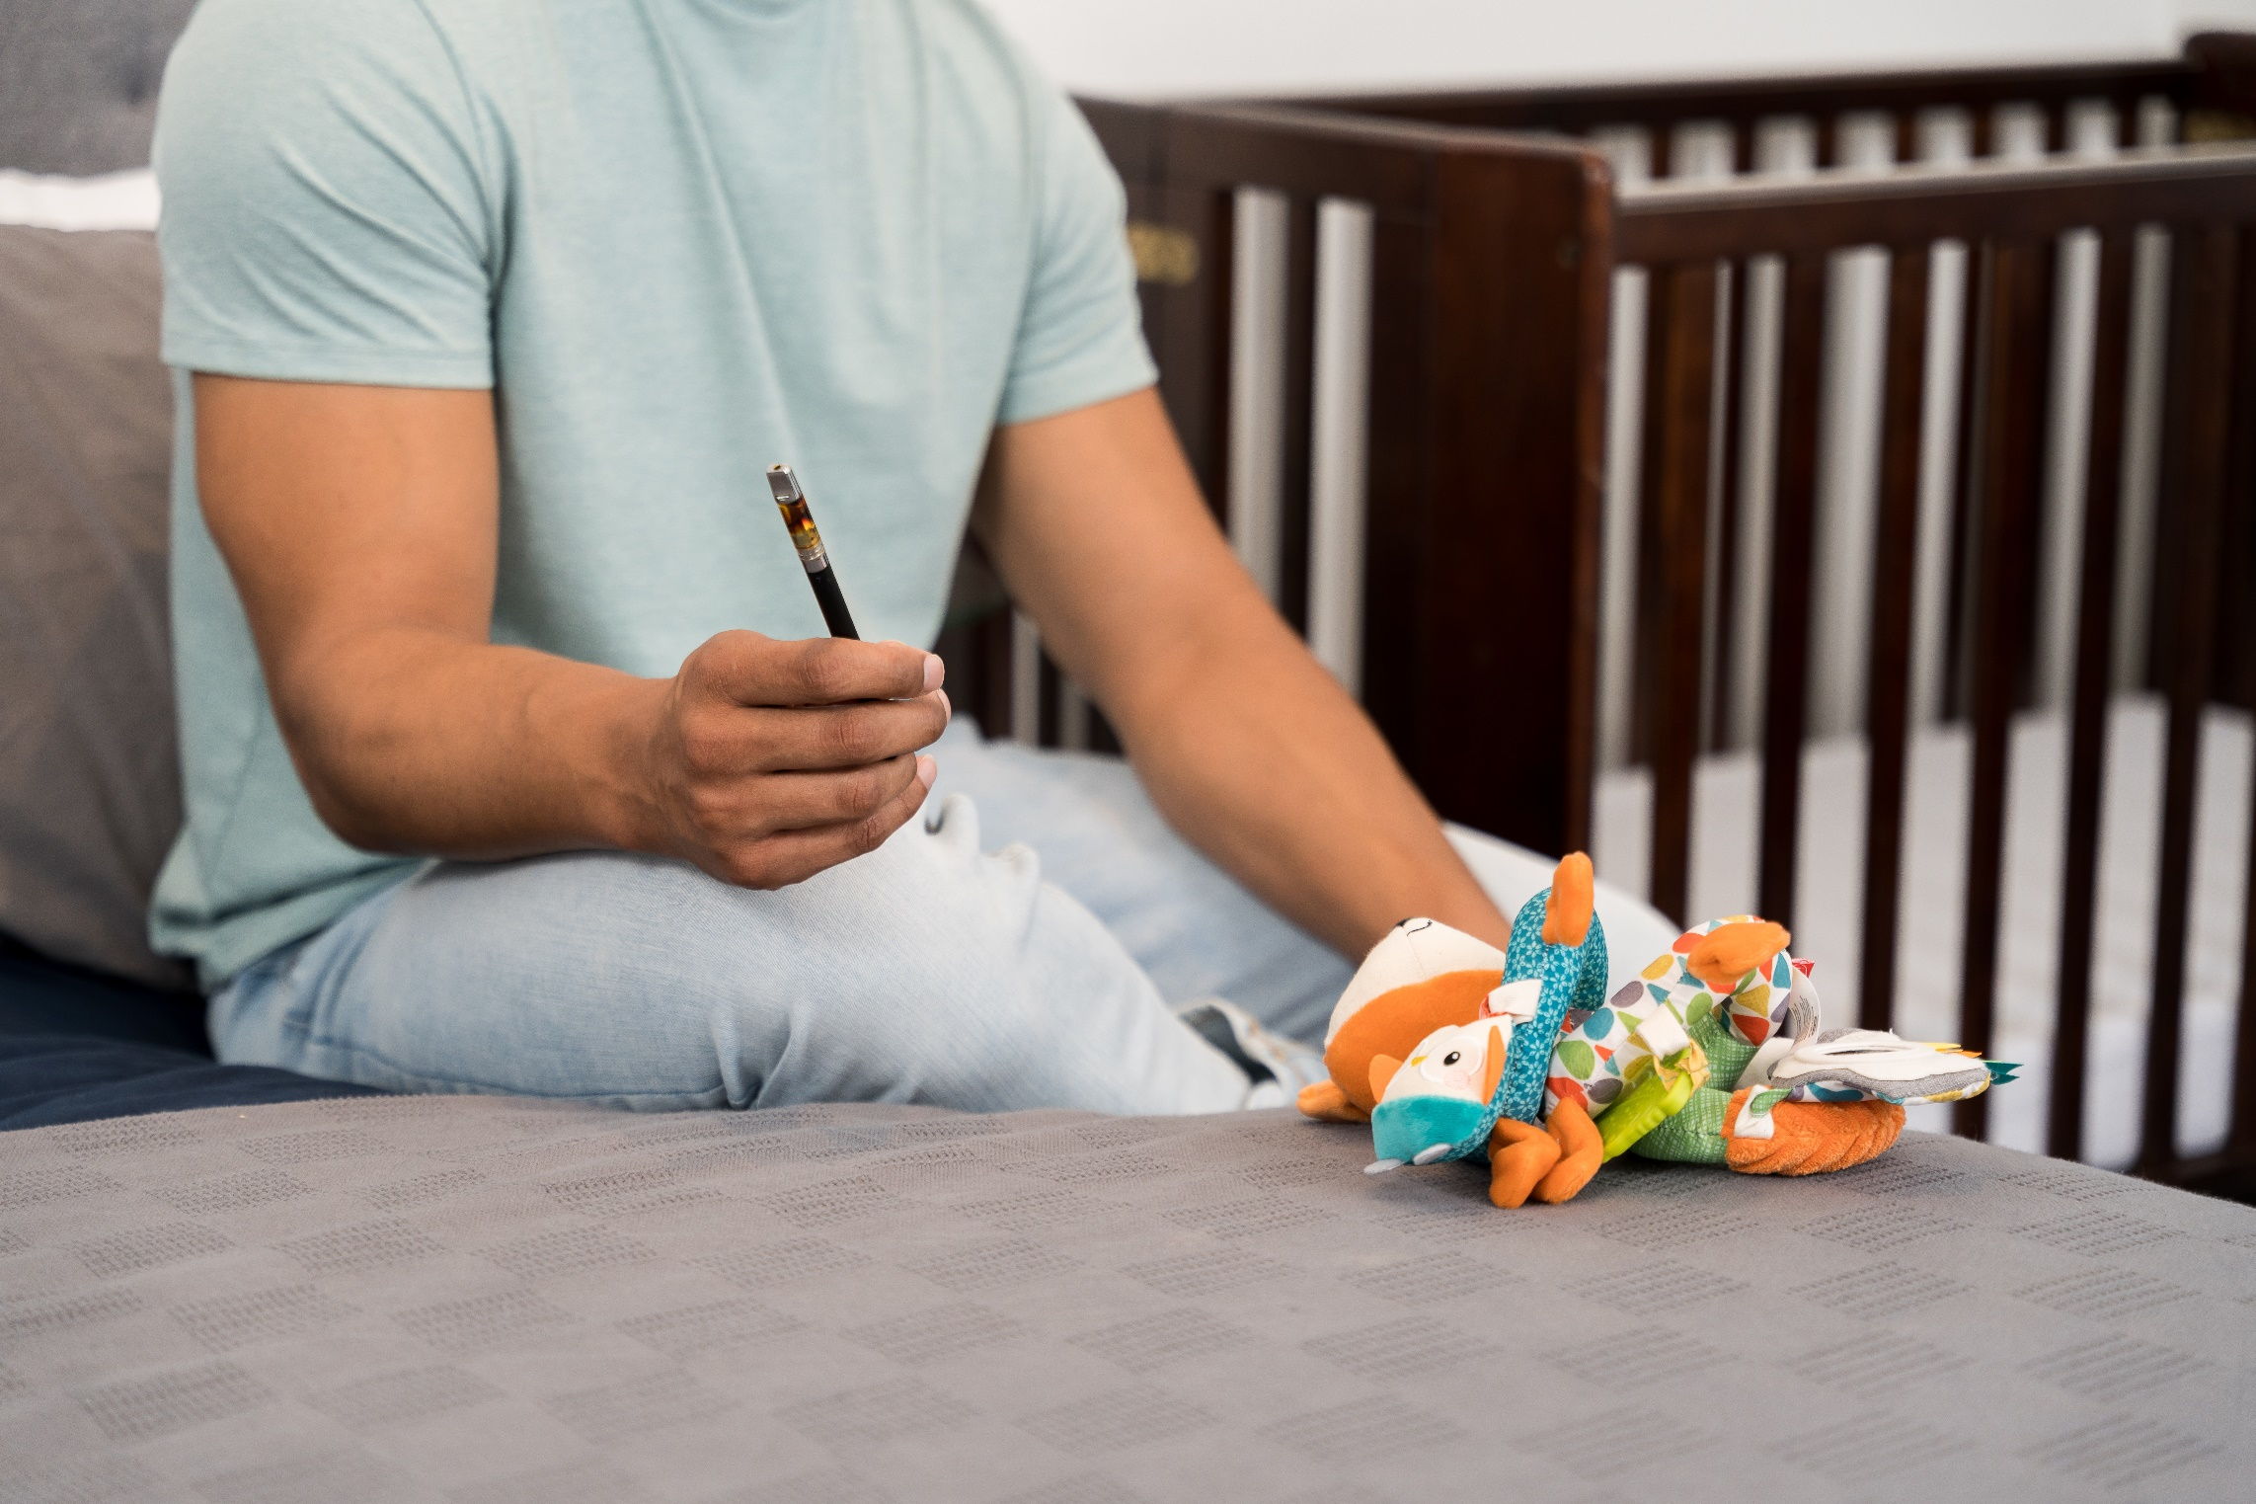
Fact
Smoke from any type of cigar or cigarette, including e-cigarettes or "vapes," contains many ingredients that are harmful to adults and young children.
Notes:
Smoke from any type of cigar or cigarette, including from e-cigarettes or “vapes”, contains many ingredients that are harmful to adults and young children.
Avoid smoke and nicotine exposure during pregnancy and after birth. Encourage families to set strict rules for smoke-free homes and cars and to eliminate secondhand tobacco smoke from all places where children and other nonsmokers spend time.
Smoke can be transferred to your baby in these ways:
Firsthand- direct use of tobacco and e-cigarettes
Secondhand- the environment around baby
Thirdhand- smoke on the clothes and other objects like blankets and furniture
Reference:
Moon RY, Carlin RF, Hand I; AAP Task Force on Sudden Infant Death Syndrome; AAP Committee on Fetus and Newborn. Sleep-Related Infant Deaths: Updated 2022 Recommendations for Reducing Infant Deaths in the Sleep Environment. Pediatrics. 2022;150(1):e2022057990
Image credit: Texas DSHS

Slide 21
Question 7
Myth or Fact
Babies do not die in cribs.

Slide 22

Myth
Just because your baby is in a crib does not mean the crib is a safe sleep environment. There are things you can do to make sure your baby’s crib is safe.
Notes:
Just because your baby is in a crib does not mean it is a safe sleep environment. There are things that you can do to make sure your baby’s crib and other sleep surfaces are safe.
Use a firm, flat, non-inclined sleep surface (eg, tightly fitting mattress in a safety-approved crib) covered by a fitted sheet with no other bedding or soft objects to reduce the risk of suffocation or wedging or entrapment. Check that your crib is not recalled by looking at the US Consumer Product Safety Commission’s recall list (especially if you received the crib as a hand-me-down).
Moon RY, Carlin RF, Hand I; AAP Task Force on Sudden Infant Death Syndrome; AAP Committee on Fetus and Newborn. Sleep-Related Infant Deaths: Updated 2022 Recommendations for Reducing Infant Deaths in the Sleep Environment. Pediatrics. 2022;150(1):e2022057990
Image credit: Texas DSHS

Slide 23
Question 8
I can use a medical device or monitor to prevent my baby from dying unexpectedly in the crib.
Myth or Fact

Slide 24
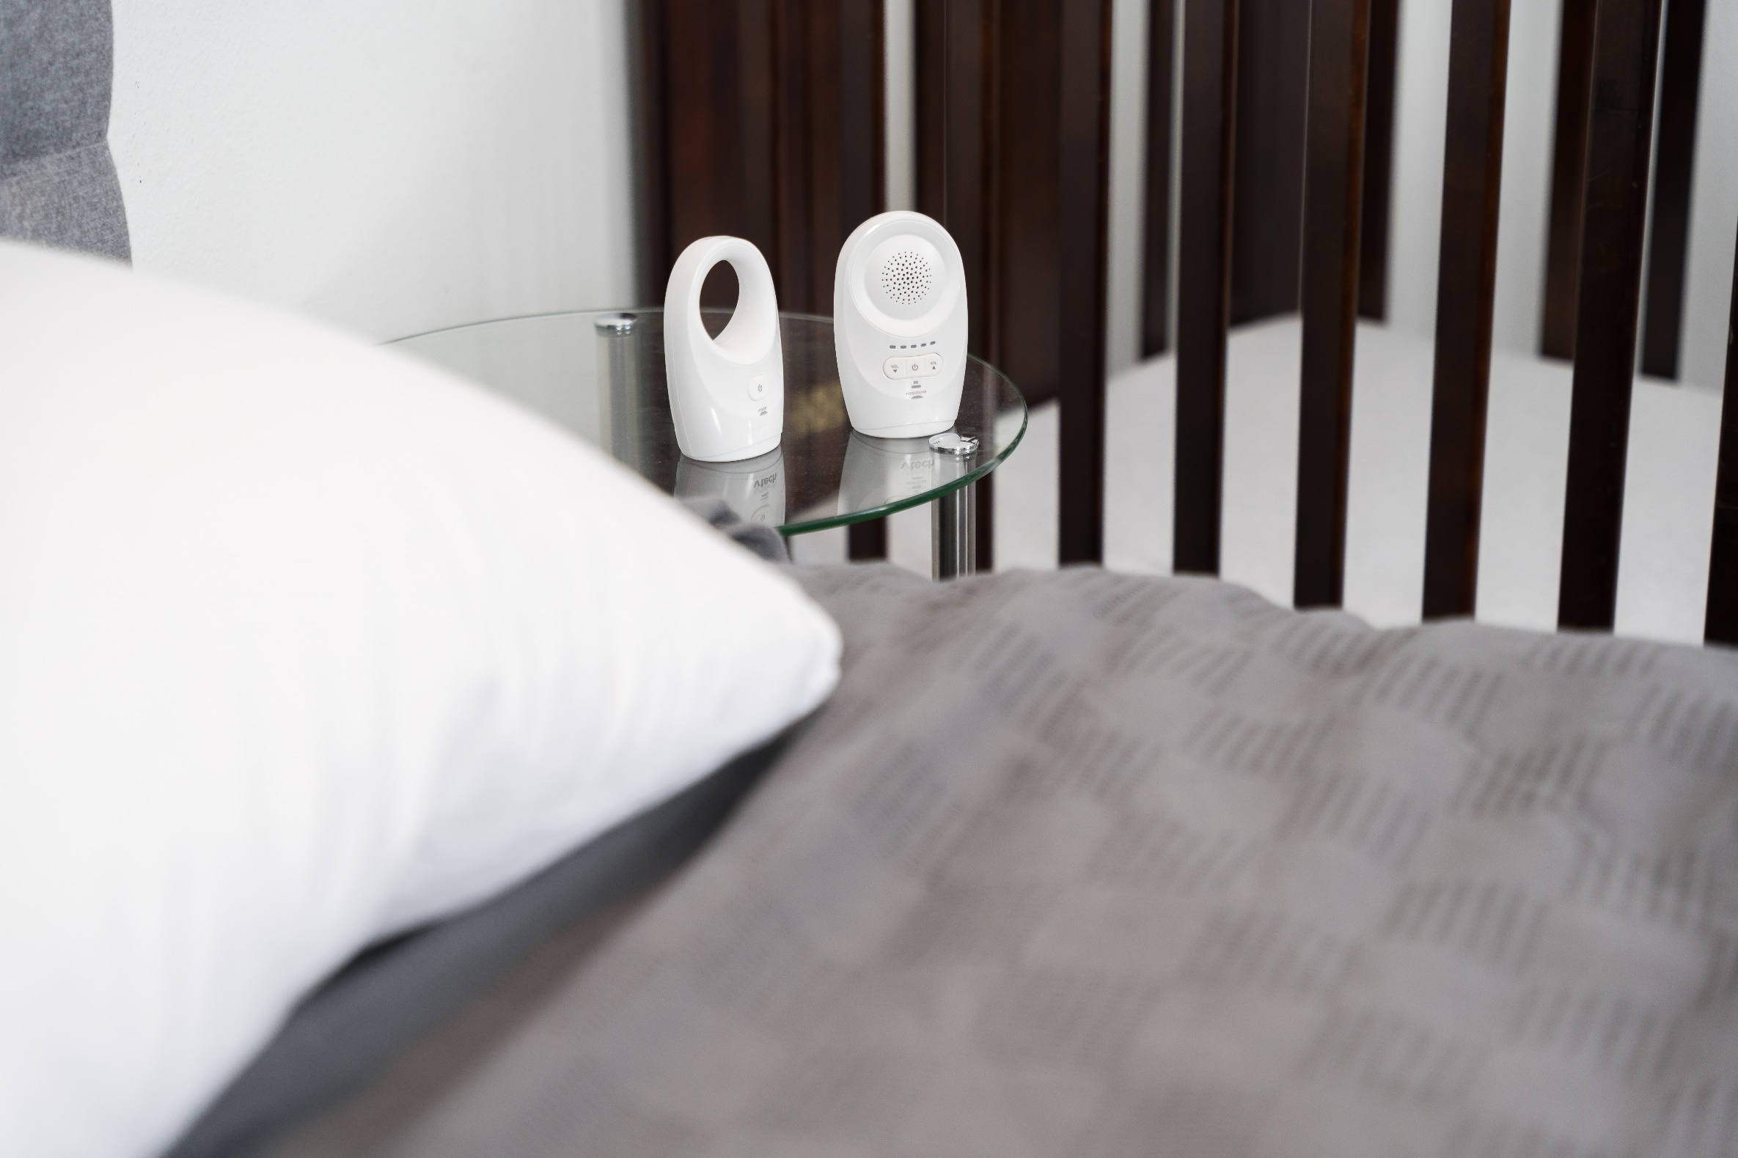
Myth
Monitors and devices should not be used as a caregiver’s main way to prevent SIDS or sleep-related infant death. This can lead to a false sense of comfort.
Many devices go against safe sleep guidance.
Devices often claim to “prevent” SIDS, but no device has been proven to prevent SIDS.
Notes:
Monitors and devices should not be used as a caregiver’s main way to prevent SIDS or sleep-related infant death. This can lead to a false sense of comfort.
Many devices go against safe sleep guidance
Devices that claim to “prevent” SIDS – do not currently have evidence to support their safety or reduced rate of SIDS.
There is no product that is sold that keeps your baby on their back and lowers their risk of death. During the time of greatest risk (2-4 months), most babies are not able to roll over on their own.
Once they can roll over on their own, this kind of product would be an item in their crib that they could potentially roll onto. It’s best to keep nothing but baby in the crib.
Image credit: Texas DSHS

Slide 25
Question 9
Babies can nap in car seats, swings, and other places if sleeping in a product that has not been recalled.
Myth or Fact

Slide 26
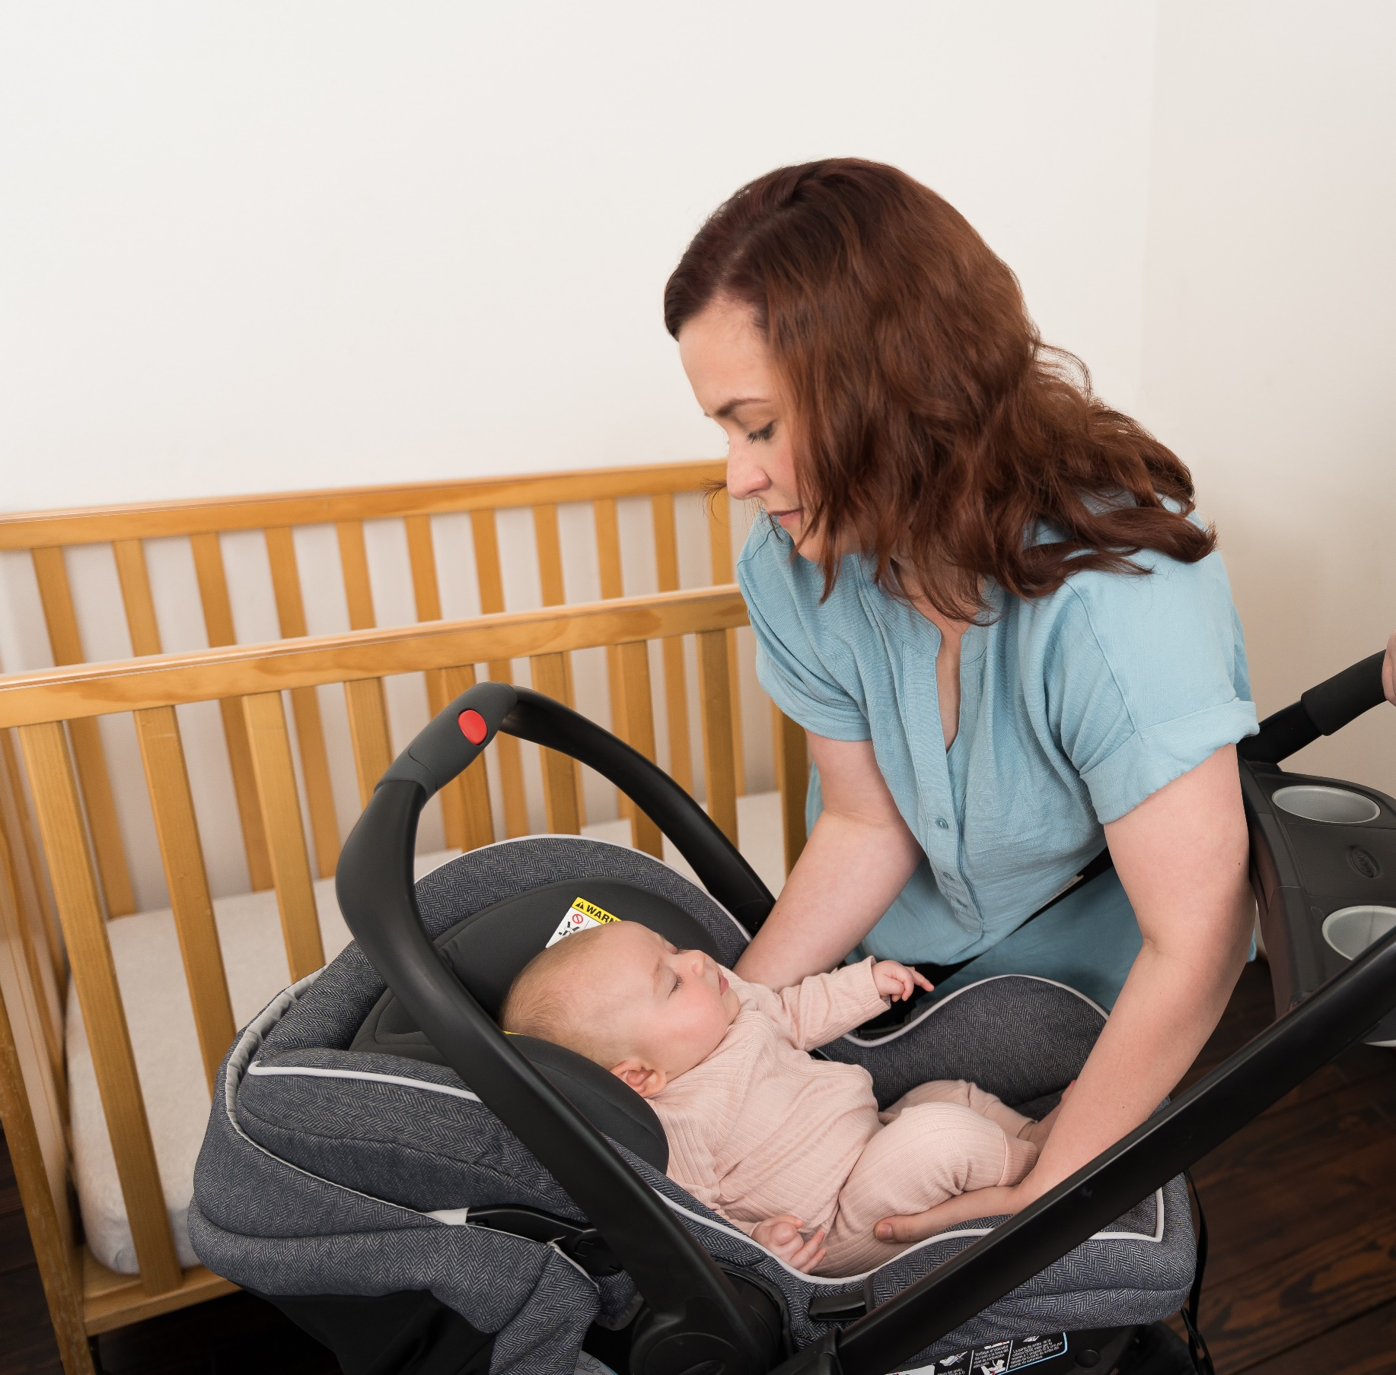
Myth
Sitting devices, such as car seats, strollers, swings, infant carriers, and infant slings, are not recommended as regular sleep surfaces.
If your baby falls asleep in a sitting device, remove your baby and place your baby on a firm, flat, and level sleep surface.
The Consumer Product Safety Commission sets safety standards for infant sleep surfaces such as a mattress, and sleep spaces like a crib.
Learn more at: cpsc.gov/SafeSleep
Notes:
Sitting devices, such as car seats, strollers, swings, infant carriers, and infant slings are not recommended for routine sleep in the hospital or at home, particularly for infants
younger than 4 months.
If your baby falls asleep in a car seat, stroller, swing, carrier, or sling, move the baby to a firm and level safety-approved*sleep surface as soon as possible.
Car seats and similar products are not stable when placed on a crib mattress or other elevated surfaces.
*The Consumer Product Safety Commission (CPSC) sets safety standards for infant sleep surfaces such as a mattress, and sleep spaces like a crib.
www.cpsc.gov/SafeSleep
Check your baby's position while sleeping in a car seat, stroller, carrier or swing. If baby sleeps too long with their chin touching their chest (slumped over), it could cut off their breathing.
Moon RY, Carlin RF, Hand I; AAP Task Force on Sudden Infant Death Syndrome; AAP Committee on Fetus and Newborn. Sleep-Related Infant Deaths: Updated 2022 Recommendations for Reducing Infant Deaths in the Sleep Environment. Pediatrics. 2022;150(1):e2022057990
Image credit: Texas DSHS

Slide 27
Question 1
X
WRONG
Return to question 1

Slide 28
Question 2
X
WRONG
Return to question 2

Slide 29
Ques tion 3
X
WRONG
Return to question 1

Slide 30
Question 4
X
WRONG
Return to question 4

Slide 31
Question 5
X
WRONG
Return to question 5

Slide 32
Question 6
X
WRONG
Return to question 6

Slide 33
Question 7
X
WRONG
Return to question 7

Slide 34
Question 8
X
WRONG
Return to question 8

Slide 35
Question 9
X
WRONG
Return to question 9

Slide 36
What Can I Do To Help Keep My Baby Safe During Sleep?
Back to sleep
Sleep surface
Breastfeeding
Room sharing
Temperature
Smoke-free and vape-free
Additional recommendations
Notes:
Now we will talk about the AAP's safe sleep practices that we mentioned earlier. This guideline was updated in 2022 and provides the most current research to help reduce your baby's risk of SIDS. If at any time you don't understand the steps presented that you can take, please let us know.

Slide 37
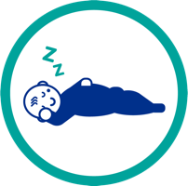
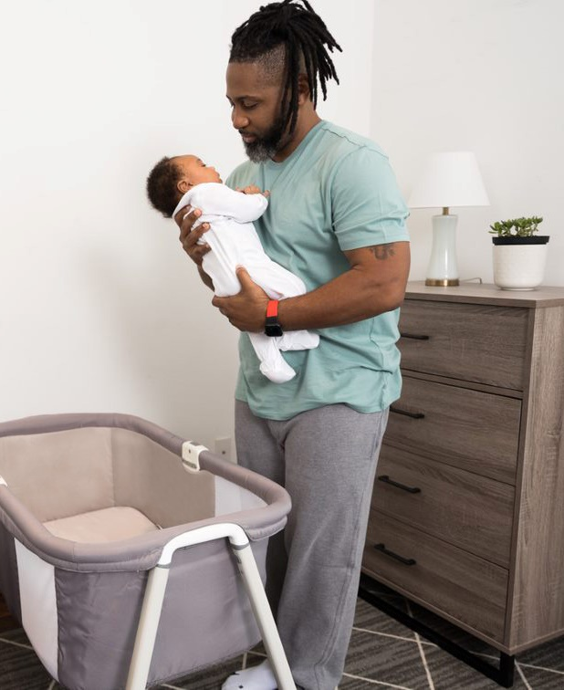
Back to Sleep for Every Sleep
Back sleeping is safest for your baby.
Babies should be placed on their backs to sleep for every sleep, including naps.
Babies who are placed to sleep on their tummies have a much higher risk of unexpected death, especially if they usually sleep on their backs.
Parents: Remember to share this information with everyone who cares for your baby.
Notes:
Once babies can roll over (around 4-6 months of age), they are at less risk. Continue to place baby to sleep on their back when putting them to sleep. If they roll over on their own, they can be allowed to sleep that way. Once babies can roll over, however, the recommendation to keep all items out of their crib is even more important so that they do not roll over onto other items in their crib.
Why is sleep position related to infant death?
Sleeping on the stomach increases the baby’s risk of re-breathing the same air that is under the baby’s face.
Sleeping on the stomach increases the risk of the baby getting overheated.
In young babies, 2 to 3 months, sleeping on the stomach changes how the nervous system controls the cardiovascular system.
(Source for information – AAP Recommendations and NCEMCH and NAPPSS Building on Campaigns with Conversations Training)
Image credit: Texas DSHS

Slide 38


Keep Your Baby’s Crib Safe
Make sure sleep surface is firm, flat, and level (not inclined) and covered only with a fitted sheet.
Take toys, stuffed animals, bumper pads, blankets, and other objects out of the crib.
Do not use wedges or positioning devices.
Do not use crib bumpers.
Only put one baby per crib; do not let baby share a crib with siblings or animals.
Notes:
Pillow top mattresses, foam mattresses and other soft surfaces are a problem because the baby’s face can get pushed into them and breathing can be blocked. These items in the baby’s sleep area can increase the risk of sleep related death by five times.
Do not place near window coverings or cords, do not hang mobiles overhead.
Do not use sleep positioners or devices.
Twins or multiple children should not share a sleep surface. This may create concerns for some families. Working with community partners can strengthen the awareness of resources available to parents and caregivers to support safe sleep environments.
How do I know if my baby’s sleep surface is safe?
Standards for safety approved sleep surfaces such as cribs, bassinets, portable play areas, and side cars (attachment to an adult bed that provides a separate, but close safe space) have been developed by the U.S. Consumer Product Safety Commission, the agency that tracks accidents and deaths with products and helps keep babies safe from products that can be harmful or cause accidents.
(Source for information – AAP Recommendations and NCEMCH and NAPPSS Building on Campaigns with Conversations Training)
Image credit: Texas DSHS

Slide 39


Feed Your Baby Human Milk, Like by Breastfeeding
Babies who breastfeed are less likely to die of SIDS.
Breastfeeding lowers your baby’s risk of SIDS, especially breastfeeding exclusively (breast milk only for the first six months).
The longer and more exclusively a baby is breastfed, the lower the baby's risk of dying from SIDS.
Notes:
Formula feeding increases a baby's risk of SIDS. This may be because breast milk protects babies from infections and diarrhea and because babies who are breastfed do not sleep as deeply and may more easily arouse themselves if they are not getting enough oxygen. Thus, the advice that parents receive to add formula to the baby’s diet to get the baby to sleep longer is counterproductive—sleeping more deeply and longer may increase risk of death.
Protection is also offered for infants who are fed expressed or pumped breastmilk by bottle.
(Source for information – AAP Recommendations and NCEMCH and NAPPSS Building on Campaigns with Conversations Training)
The following information should be provided to parents regarding feeding:
For those that are not directly breastfeeding, or are feeding breastmilk by bottle
safe handling and storage of breastmilk
safe preparation of the bottle and all feeding implements
safe preparation of formula
(Source for feeding information-CDC- Guidelines and Recommendations: https://www.cdc.gov/breastfeeding/recommendations/index.htm)
Image credit: Texas DSHS

Slide 40
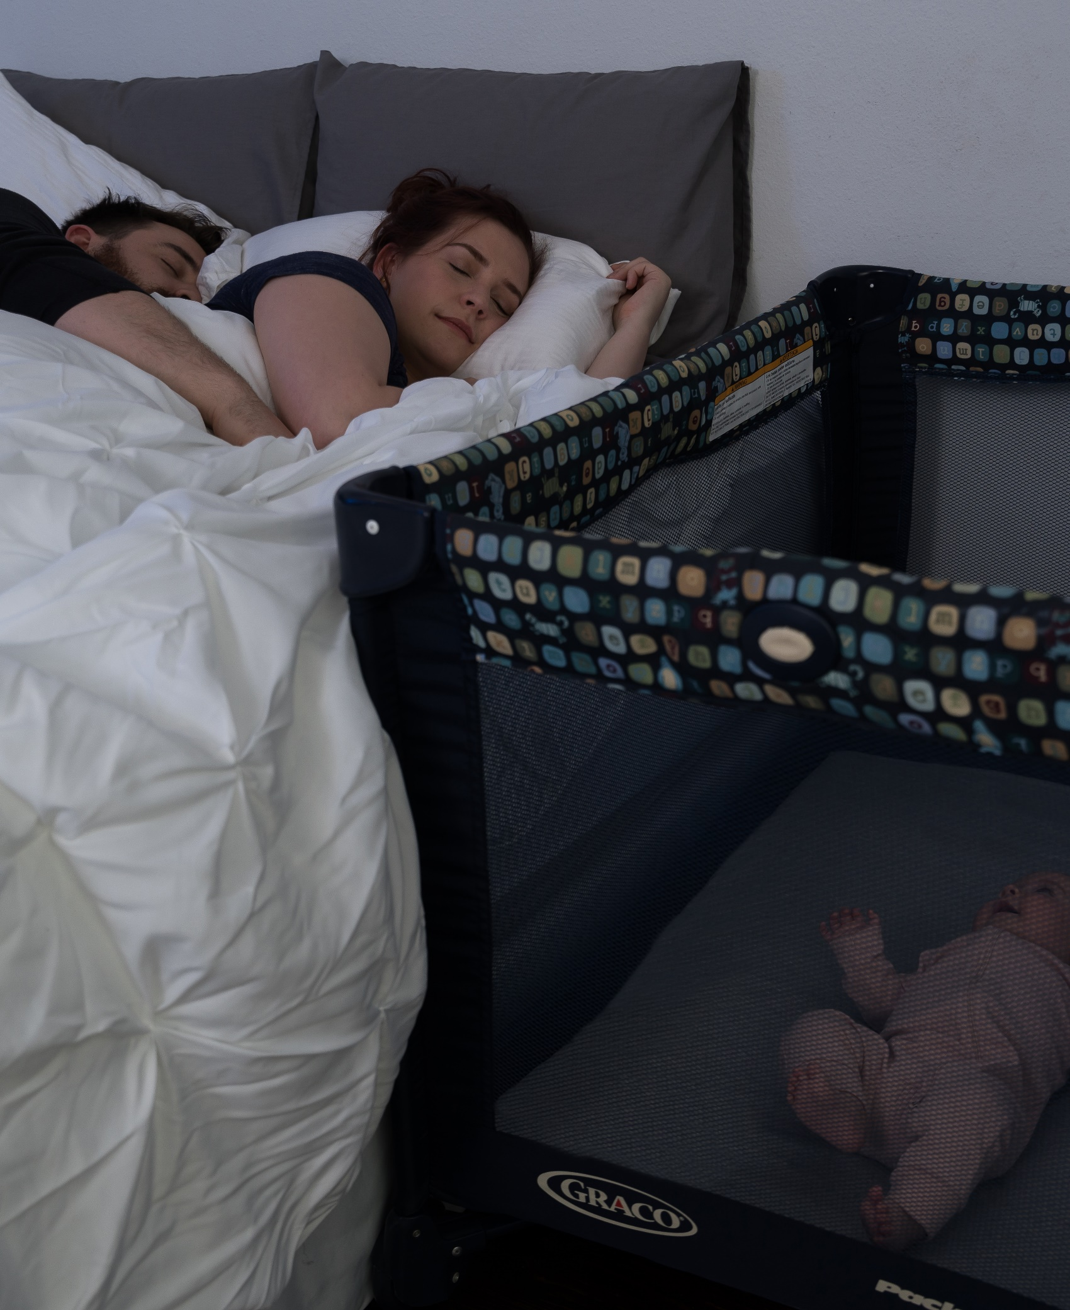
Share Your Room With Your Baby
Room-share for at least the first six months and ideally the first year.
Your baby should have his or her own safety-approved sleep surface.
When bringing your baby into an adult bed for feeding or comforting, remove all soft bedding, toys, and pillows.
If you fall asleep while feeding or comforting, as soon as you wake, place the baby back on a separate sleep surface made for babies, like a bassinet or crib.
Notes:
There is evidence that sleeping in the parents’ room but on a separate sleep surface reduces the risk of SIDS by as much as 50%.
Placing the crib close to the parents’ bed allows the parents to see and respond to their baby, monitor their baby's needs and can make feeding and comforting easier. Babies who room-share with parents have more small awakenings and this may keep them from sleeping too deeply in a way that increases the risk of sleep-related death. Finally, room sharing supports continued breastfeeding and its protective effects and positive health benefits.
Avoid placing your baby to sleep on a couch, armchair, or sitting device like a swing, baby seat, or car safety seat (except when in a car).
(Source for information – AAP Recommendations and NCEMCH and NAPPSS Building on Campaigns with Conversations Training)
Image credit: Texas DSHS

Slide 41

Breastfeeding and Sleeping
Sleep near your baby.
Consider using a co-sleeper attached to your bed (also called a sidecar). Breastfeed while lying on your side.
Avoid getting up at night.
Sitting up and getting out of bed will disrupt your sleep.
Avoid unnecessary diaper changes at night. Protect your baby’s bottom with a barrier cream.
Breastfed babies don’t usually require burping.
Bedsharing safety is very important.
Bedsharing is often unplanned. Everyone should make their bed safe for baby.
Notes:
Breastfeeding and breastmilk offer health benefits to both mom and baby. The American Academy of Pediatrics recommends feeding only human milk—with no added formula or other foods or liquids (sometimes called exclusive breastfeeding)—for at least baby’s first 6 months, and continued breastfeeding through 2 years. Your baby can receive breastmilk through direct breastfeeding or by feeding breastmilk pumped from the breast.
It is normal to feel drowsy or sleepy while breastfeeding. This is because mechanics hormones released during suckling can cause drowsiness, so developing a plan to combat falling asleep is important.
Placing the crib close to your parents’ bed allows you to see and respond to your baby sooner and can make feeding and comforting your baby easier. Room sharing infants have more small awakenings and this may keep them from sleeping very deeply in a way that increases the risk of sleep related death.
Avoid feeding your baby on a couch or armchair as this is dangerous and could lead to your infant falling from your arms. When bringing your baby into your bed for feeding or comforting, remove all soft bedding, toys, and pillows.
Academy of Breastfeeding Medicine, ABM Clinical Protocol #37: Physiological Infant Care—Managing Nighttime Breastfeeding in Young Infants. BREASTFEEDING MEDICINE
Volume 18, Number 3, 2023 DOI: 10.1089/bfm.2023.29236.abm
Image credit: Texas DSHS

Slide 42

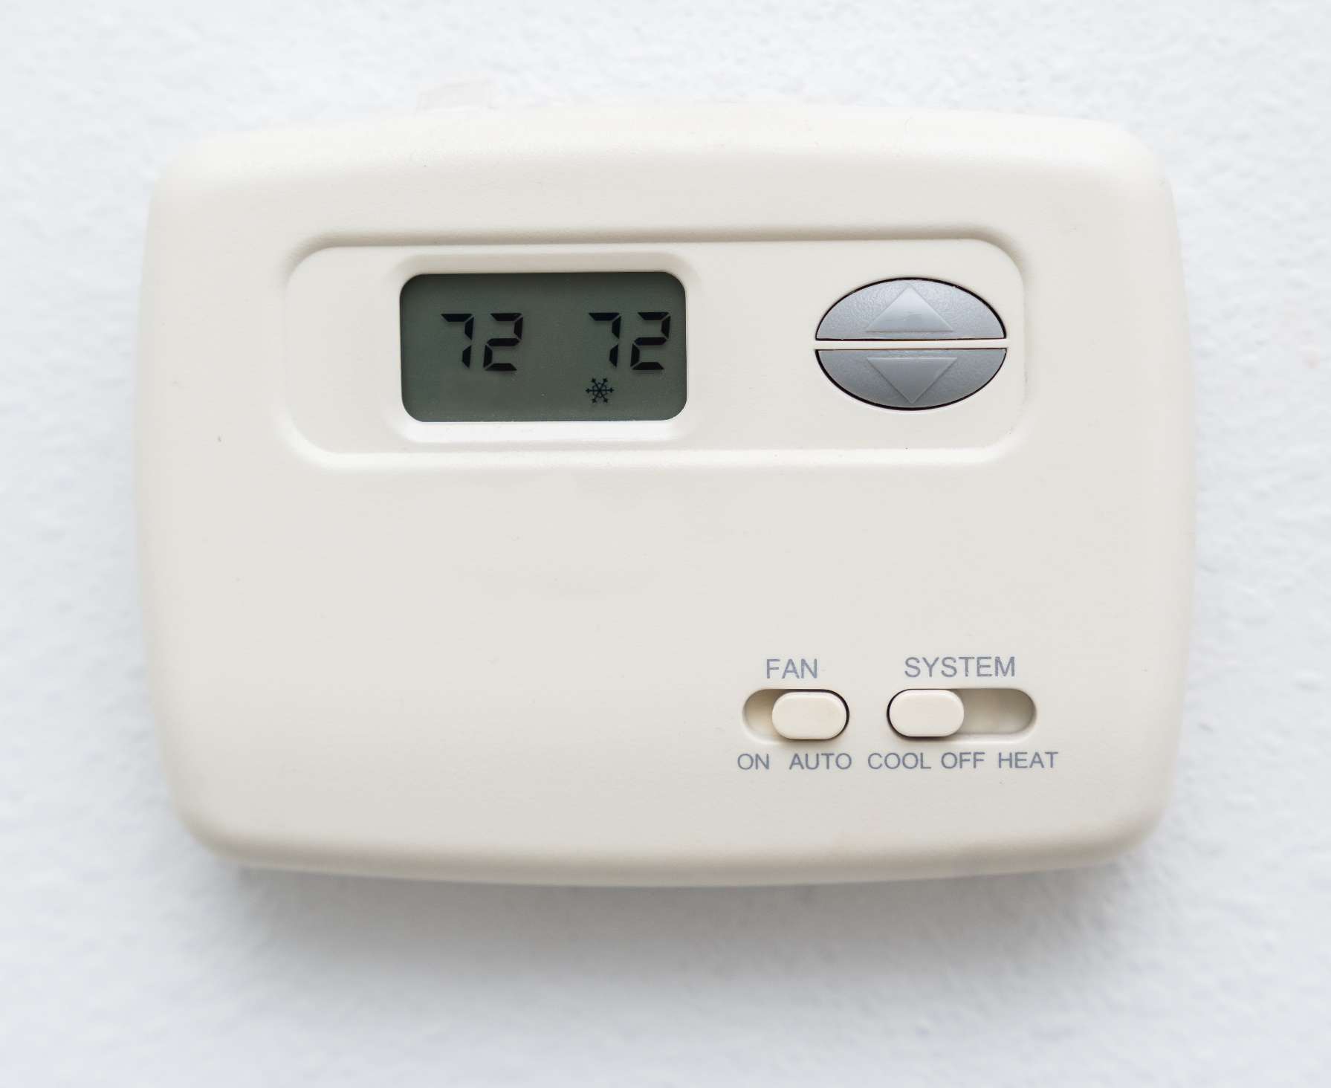
Keep Your Baby From Getting Too Hot
If your baby gets too hot, your baby may have trouble waking up and getting oxygen.​
Keep the room temperature where baby is sleeping comfortable enough for a lightly clothed adult.​
Use a lightweight sleep sack instead of a blanket.​
Keep your baby's head free of hats or other covering when indoors. A sweaty or damp baby is too hot.
Notes:
Generally, if the room temperature is comfortable for you, it’s most likely comfortable for your baby too! To keep your baby warm, use a sleep sack or footed- sleep clothing. You can also dress your baby in layers that can be removed if their face becomes too red or if you notice they are sweating.​
​
Blankets, wearing hats indoors, and too many layers of clothing can trap in body heat. Blankets also increase the risk of something covering their head and face, making it harder for your baby to breathe.​
​
Young babies and those born too early sometimes have trouble keeping a normal body temperature which can also impact how their heart and other body systems work
(Source for information – AAP Recommendations and NCEMCH and NAPPSS Building on Campaigns with Conversations Training)
Image credit: Texas DSHS

Slide 43


Stay Smoke- and
Vape-Free While Pregnant and After Birth
Smoking during pregnancy increases the risk of your baby dying from SIDS.
Exposure to smoke after birth may also increase your baby’s risk of dying from SIDS.
Do not let anyone smoke or vape around your baby.
Notes:
The chemicals given off from smokers (even if they are not smoking directly near the baby) impact the functioning of the baby’s nervous system and can have negative effect on the baby’s ability to wake up if she is not getting enough oxygen. Also these chemicals increase the baby’s risk for respiratory and other infections that are associated with higher risk of sleep related death and are of course, not good for the overall health of the infant and other children in the household.
It is also important to avoid alcohol and drugs while pregnant and after birth. Using alcohol or drugs impairs a parent’s judgment in general, however, there appears to be a particular risk when bed sharing—the parent is not as easily roused by and attuned to cues of distress from the baby. This concern applies to prescription or over the counter medications that are sedating—cause drowsiness or sleepiness—not just illegal drugs.
(Source for information – AAP Recommendations and NCEMCH and NAPPSS Building on Campaigns with Conversations Training)
Image Credit- iStock photo purchased for unlimited use by DSHS Tobacco Prevention and Control (used with permission).

Slide 44
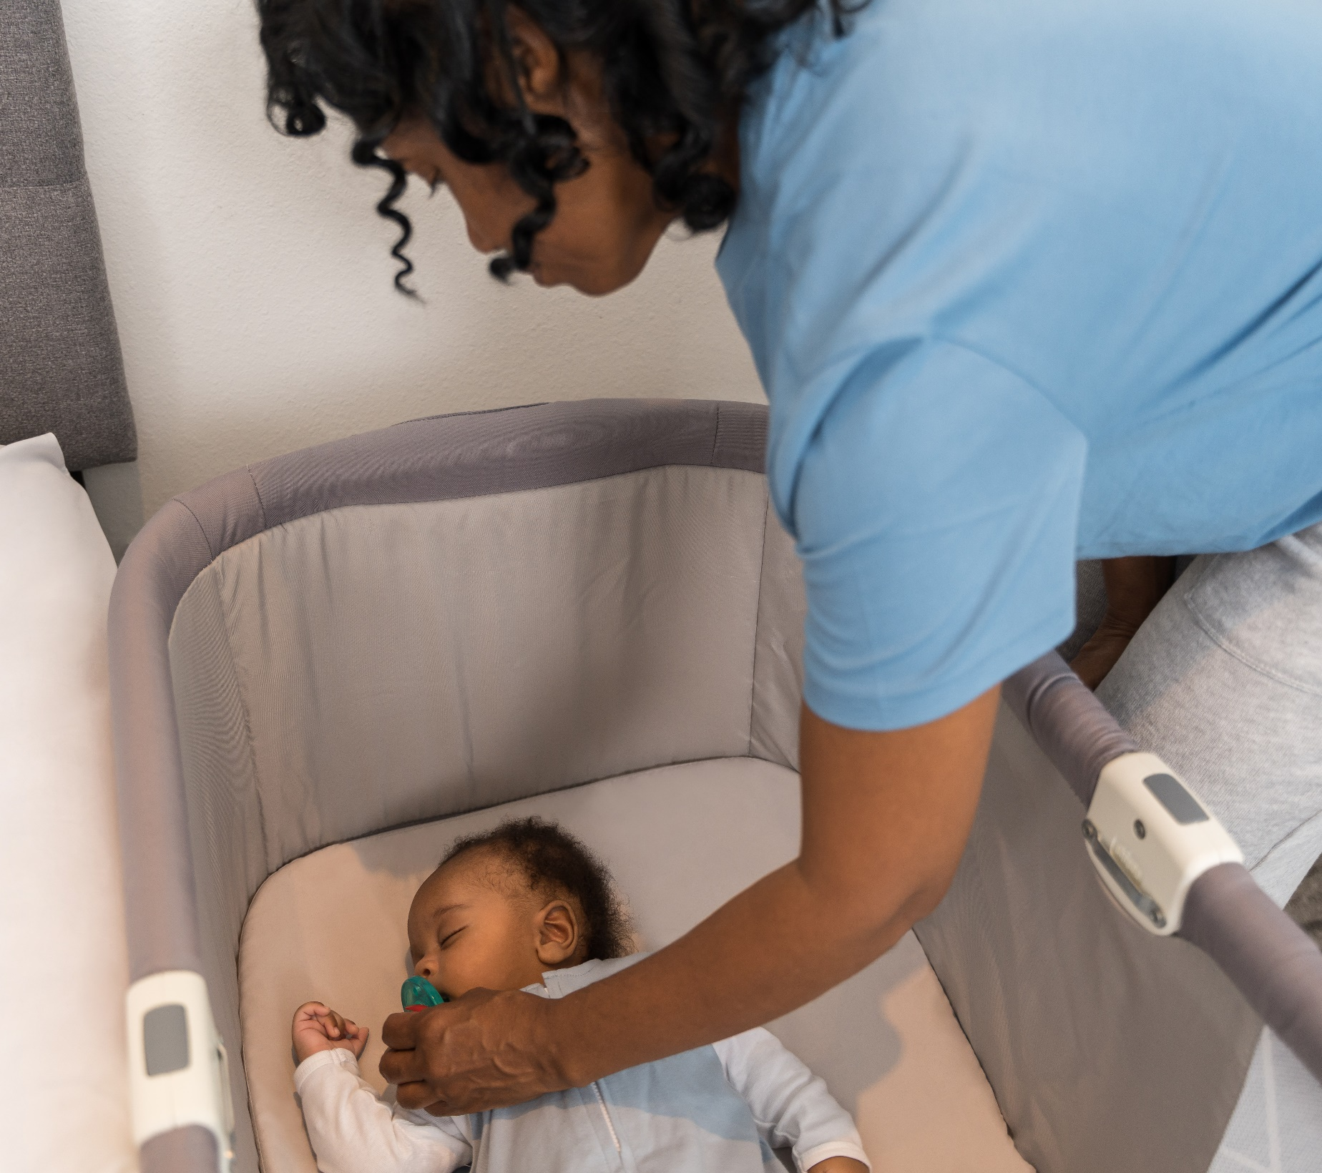
What Else Can I Do To Keep My Baby Safe During Sleep?
Once breastfeeding is well established, offer pacifier when laying the baby down for sleep (naps and at night).
Stay drug- and alcohol-free during pregnancy, and make sure anyone caring for the baby is drug- and alcohol-free.
Get regular medical care throughout pregnancy.
Follow health care provider advice on vaccines, checkups, and other health issues for the baby.
Notes:
Suckling, either during breastfeeding or when using a pacifier during sleep may help keep your baby from sleeping too deeply. For breastfeeding infants, pacifiers can be introduced once breastfeeding is going well. This is determined by:
Baby is calm and satisfied after feeding
There is no pain for mom when baby breastfeeds
Baby is gaining weight and growing well
(Source for Information- Academy of Breastfeeding Medicine- Clinical Protocol #3- Supplementary Feedings in the Healthy Term Breastfed Neonate, Revised 2017)
When using a pacifier, remember:
Use a pacifier that is fee of toys, cords, and never attach it to your baby's clothes to avoid choking, strangulation, or suffocation.
Do not coat the pacifier with sweet liquids or honey.
If the pacifier falls out of your baby’s mouth during sleep, you don’t need to put it back.
Finger or thumb sucking does not reduce SIDS risk.
Babies exposed to alcohol and drugs during pregnancy and after birth may have a harder time waking up when they need help.
It may be helpful to share some of the dangers of alcohol and drug use with anyone caring for your baby such as:
They are more likely to roll over onto your baby during sleep if you drink, use drugs, or take medication that makes you sleepy while sharing a bed with your baby.
Sharing a bed with your baby is also riskier if you or anyone else who is also a smoker.
The best thing you can do for your health when pregnant and baby's health is to quit using alcohol, drugs, and smoking.
Ask your doctor for help to develop a plan for quitting.
Prenatal care and baby check-ups
Find a doctor as soon as you know you are pregnant and get regular medical care during pregnancy. Your doctor will keep you updated on important health and safety topics for you and your baby.
Follow your doctor or clinic's advice on shots, checkups, and other health concerns for your baby. Vaccines help babies stay healthy, which may protect them from SIDS.
(Source for information – AAP Recommendations and NCEMCH and NAPPSS Building on Campaigns with Conversations Training)
Image credit: Texas DSHS

Slide 45
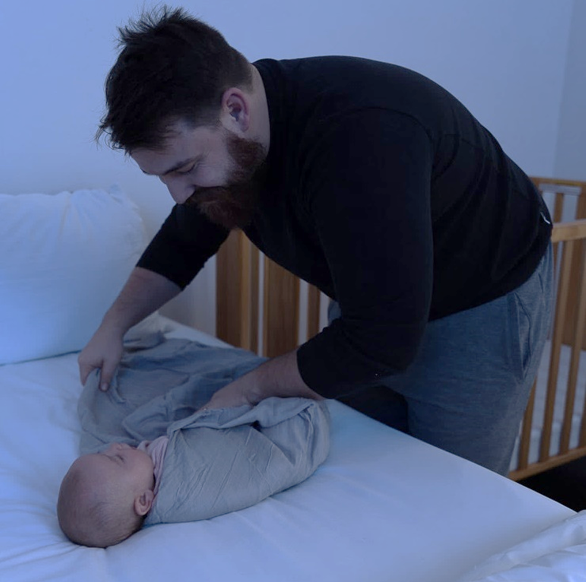
Other Recommendations
If you are using a monitor or other device for reasons other than to detect SIDS, make sure you also follow all safe sleep practices.​
Do not swaddle when your baby starts to roll over, and keep in mind that swaddling does not reduce SIDS risk.
If your baby is placed on his or her stomach or rolls onto his or her stomach while swaddled, baby's risk of death is higher.
Notes:
Monitors and Devices
If you are using a monitor or other device for reasons other than to detect SIDS, make sure you also follow all safe sleep practices.​
If you have questions....talk with your baby's doctor.​
If your baby was born too early or has a special health issue, talk with their doctor about how to follow safe sleep practices.
Swaddling:
If a baby is placed on their stomach or rolls onto their stomach while swaddled, their risk of death is higher.
If you do choose to swaddle, follow these recommendations: ​
Make sure the swaddle is wrapped snugly so that the blanket isn't loosened during sleep. ​
Do not swaddle so tightly that your baby cannot move their hips.​
Avoid swaddling your baby all the time, only when fussy or sleeping. ​
Do not use weighted blankets, clothing , or objects within swaddles. ​
Avoid swaddling once baby starts to roll over (2-3 months of age).​
Check your baby for signs of overheating.
(Source for information – AAP Recommendations and NCEMCH and NAPPSS Building on Campaigns with Conversations Training)
Image credit: Texas DSHS

Slide 46


What Does Tummy Time Have To Do With Safe Infant Sleep?
Tummy time helps your baby develop arm, shoulder, and neck strength. This helps them move better too!​
Supervised tummy time helps your baby's brain grow by learning and playing.​
Give your baby tummy time each day and ask your baby's caregivers to use tummy time too.
Notes:
Tummy time strengthens muscles that support your baby's head and may help to prevent flat spots on your baby's head. ​Tummy time can start a few days after birth, for short periods of time, a few times a day. You can increase this time as your baby gets stronger. By about 2 months of age, babies should be getting at least 15 to 30 minutes of total tummy time daily. Fathers and other support partners can do tummy time directly on their chest.
There are a few things you can do to help your baby enjoy tummy time:​
-Talk or sing to your baby​
-Show them toys​
-Read them short stories​
-Play and laugh with them
(Source for information – AAP Recommendations and NCEMCH and NAPPSS Building on Campaigns with Conversations Training)
Image credit: Texas DSHS

Slide 47

What Is Normal Baby Behavior?
You may be concerned about the following issues:
  How your baby eats
  How well your baby sleeps
  Why your baby cries
Knowing how to tell what your baby is asking for is a great way to stick to your safe sleep plan.
Notes:
These are common concerns for parents and can impact how well you use safe sleep practices. There is research now that helps us to better understand the language that your baby uses to let you know what they need. We call this "normal Baby Behavior."
When you know what to expect from your baby's normal growth and development, you can plan for issues when they come up and keep to using safe sleep practices.
Share any advice you have received about sleeping, crying, and feeding your baby. Have you ever heard about normal newborn behavior?
(Information Source: Texas WIC (breastmilkcounts.com) and Dr. Jane Heinig, UC Davis California)
Image credit: Texas DSHS

Slide 48

What Does “Normal” Infant Sleep Look Like?
Facts about normal infant sleep:
It is normal for infants to wake up often at night.
Newborns spend more time in light and active sleep which helps them wake more easily to eat, stay warm, and move when needed.
As your baby gets older, your baby will sleep for longer stretches of time and spend more time in deep sleep.
Dreaming happens more in light sleep which helps the brain to grow.
Notes:
What do you think of when you hear the phrase “sleep like a baby”?
Society does not often provide support for new parents. Parents are often juggling the care of infants with their own health needs, work, and other roles and responsibilities. Society also has unrealistic ideas about infant sleep. (As evidenced by the commonly asked question: “Is baby sleeping through the night?”)
Frequent awakenings throughout the night support breastfeeding and keep infants safe.
Practices such as placing infants to sleep on their stomachs or giving them formula or cereal before bed do NOT lead to infants sleeping through the night sooner.
Infants don't follow the same light and dark patterns as adults do. This is why they often seem to have "their days and nights mixed up.” As they get older, they follow these patterns more like adults. Establishing a day/ night routine can help with this
(Information Source: Texas WIC (breastmilkcounts.com) and Dr. Jane Heinig, UC Davis California)
Image credit: Texas DSHS

Slide 49
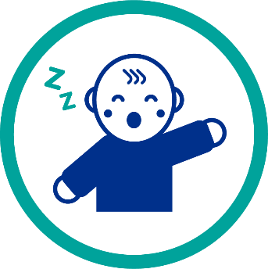
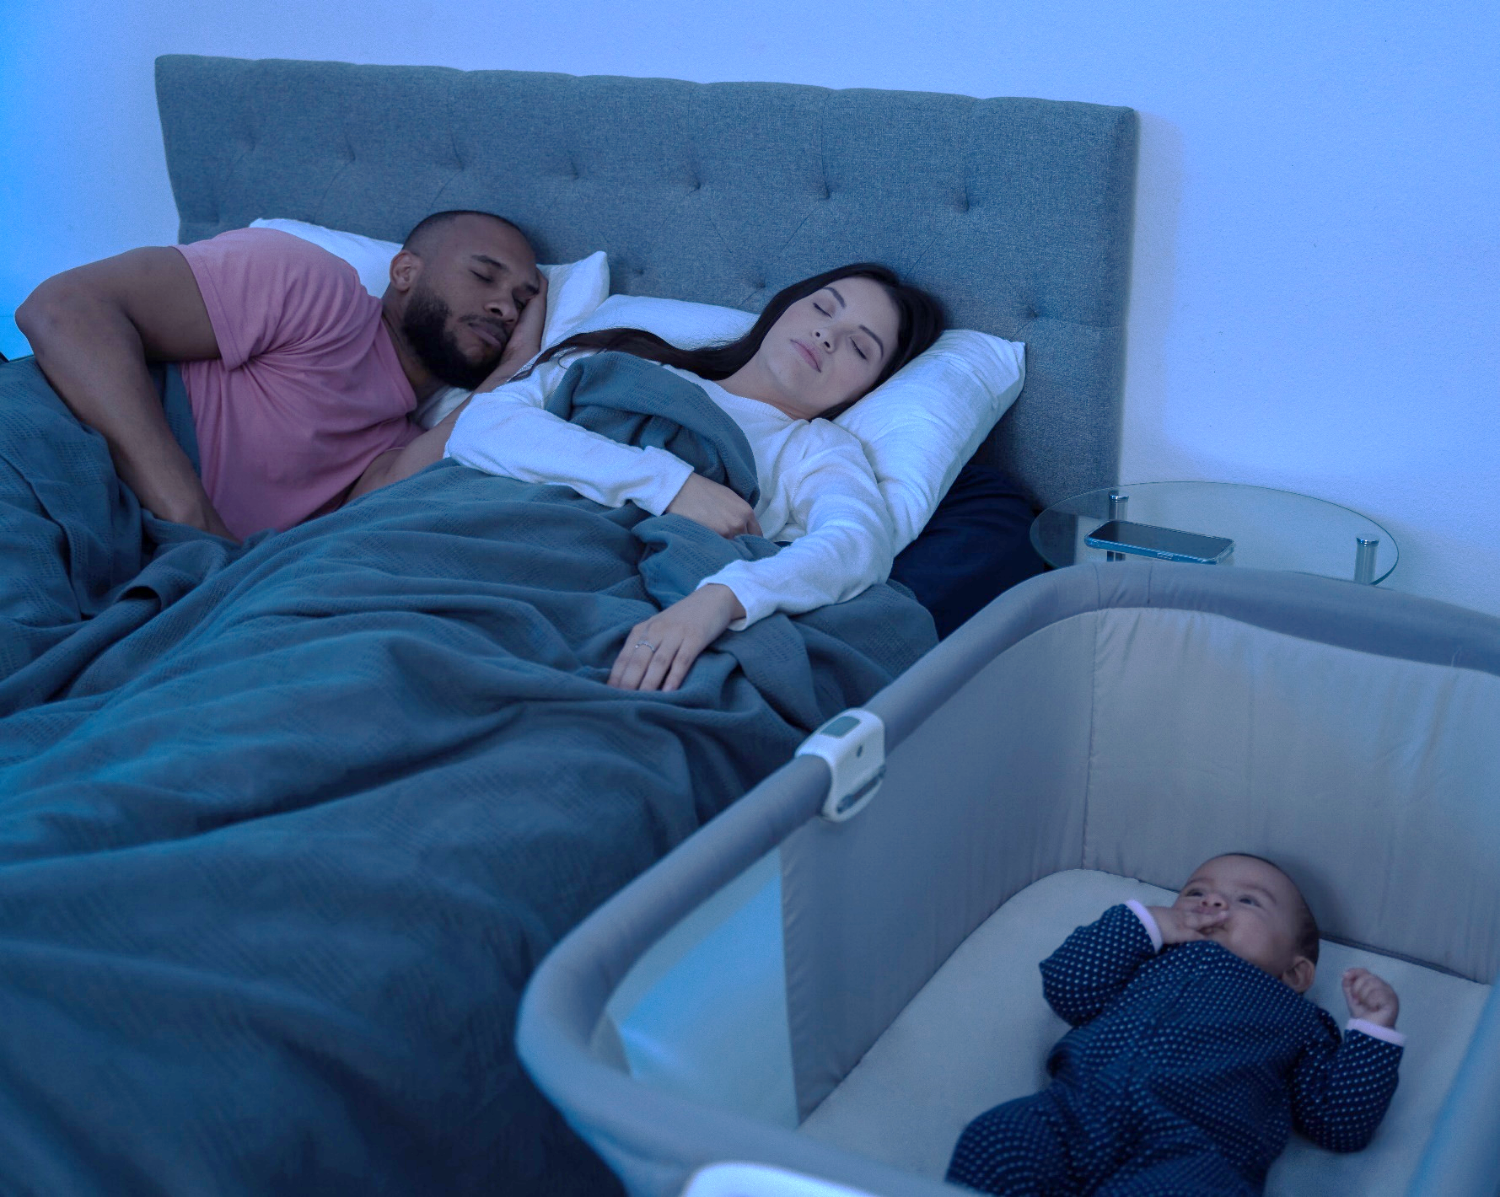
Baby Behavior - Sleep
When your baby wakes at night, the baby is signaling a need. The baby may wake up less at night as your baby gets older.
​It is normal for your baby to wake up often at night.​
Newborn babies spend more time in light sleep, which also helps to protect their health. ​
Notes:
There are many reasons young babies don't (and shouldn't) sleep through the night.​
Newborns spend a lot of time in light sleep, when they dream. Just like adults, they are more likely to wake when they are dreaming. ​
If babies sleep too deeply, they may not be able to wake up if they get too hot or cold or if they need more air.​
Waking up at night can help your baby let you know what they need to be comfortable and safe.
It is understandable that new parents might be looking for answers to get more sleep.
This is a time of adjustment for the whole family. It is normal for newborns to wake often during the night to eat or communicate other needs, so training your baby to sleep longer actually goes against their normal development. ​
(Information Source: Texas WIC (breastmilkcounts.com) and Dr. Jane Heinig, UC Davis California)
Image credit: Texas DSHS

Slide 50
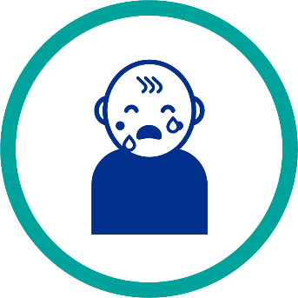

Baby Behavior - Crying
Crying is your baby's way of saying, “Something needs to change now!“
Ways to calm your baby can include:
Holding your baby close or in skin-to-skin contact​.
Speaking or singing softly to your baby using calming sounds or words​.
Rocking your baby gently with a back-and-forth motion.​
Gently massaging your baby's back, arms, and legs.
Crying doesn't always equal hunger.
Notes:
Babies will use cues or signs to try to let you and other caregivers know what they need before they start to cry. But those cues might be hard to understand or can be missed when you are first learning to care for your baby. It is common for parents and caregivers to think that all crying means your baby is hungry.
If you or someone caring for your baby is concerned that your baby wants to feed all the time. It can be helpful to explain:
There may be times when it feels like your baby wants to nurse more often for short periods of time during the day—sometimes every hour.
This is called “cluster feeding” and it tends to last only a few days.
You can be sure that cluster feeding is okay if your baby is gaining weight and growing well and has some time between feedings when they are content.
If your baby is crying and not using cues that you understand, try these things when helping to soothe your baby: ​
Go to a quiet room with a small amount of light ​
Rock your baby gently with a repetitive motion ​
Burp your baby as gas may be bothering them
Play soft music or white noise
Other ways to calm your baby include holding baby's bare skin on your bare chest (skin-to-skin), changing their diaper, baby massage, or taking your baby for a walk in a carrier such as a sling or stroller.
Some babies may have a harder time dealing with the world around them. These babies may cry often and for long periods of time or have a hard time calming down once they start crying.
(Information Source: Texas WIC (breastmilkcounts.com) and Dr. Jane Heinig, UC Davis California)
Image credit: Texas DSHS

Slide 51


Baby Behavior - Feeding Cues
Babies use signals or cues to let parents and caregivers know when they want to start or stop eating.​
When babies are ready to eat, they may:
  Move their hands or fists to their mouth​.
  Make sucking motions or soft noises​.
  Smack their lips​.
  Nuzzle against you or search for your breast.
When babies are full and want to stop eating, they may:
  Release or "fall off" the breast or bottle.​
  Turn away from the breast or nipple​.
  Relax their body and open their hands.
Notes:
It is good to know and share information with anyone caring for your baby on the special language your baby uses called "cues" that tells you when they are hungry or full. Look for these signs from your baby- it gets easier over time to understand your baby's language and helps you stick with your safe sleep plan!
If you have questions about overfeeding your baby or using infant formula to encourage your baby to sleep, know that:
Babies who are breastfed usually eat the right amount for their age and weight, especially if you feed them whenever they show signs of hunger.​
Feeding your baby too much by bottle (with either formula or breastmilk) so that they sleep longer is not recommended and may reduce their protection against SIDS.
There may be times when it feels like your baby wants to nurse more often for short periods of time during the day—sometimes every hour.
This is called “cluster feeding” and it tends to last only a few days.
You can be sure that cluster feeding is okay if your baby is gaining weight and growing well and has some time between feedings when they are content.
(Information Source: Texas WIC (breastmilkcounts.com) and Dr. Jane Heinig, UC Davis California)
Image credit: Texas DSHS

Slide 52
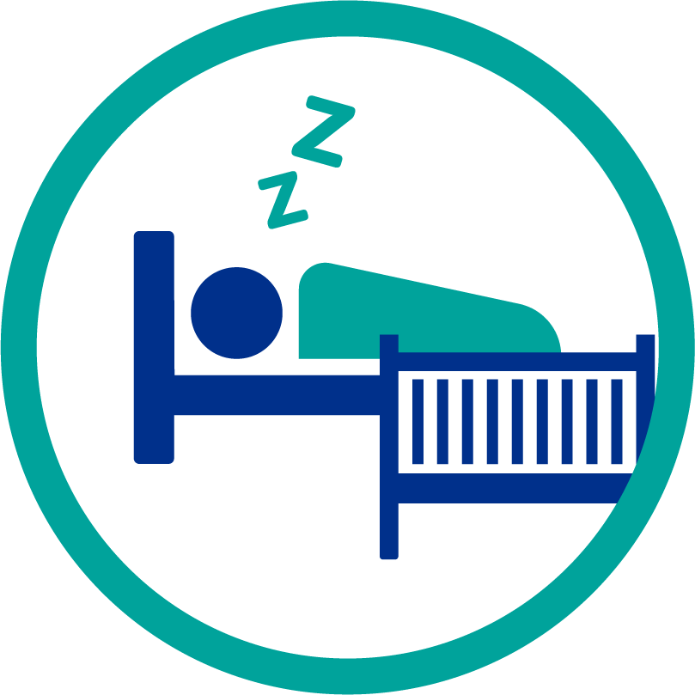
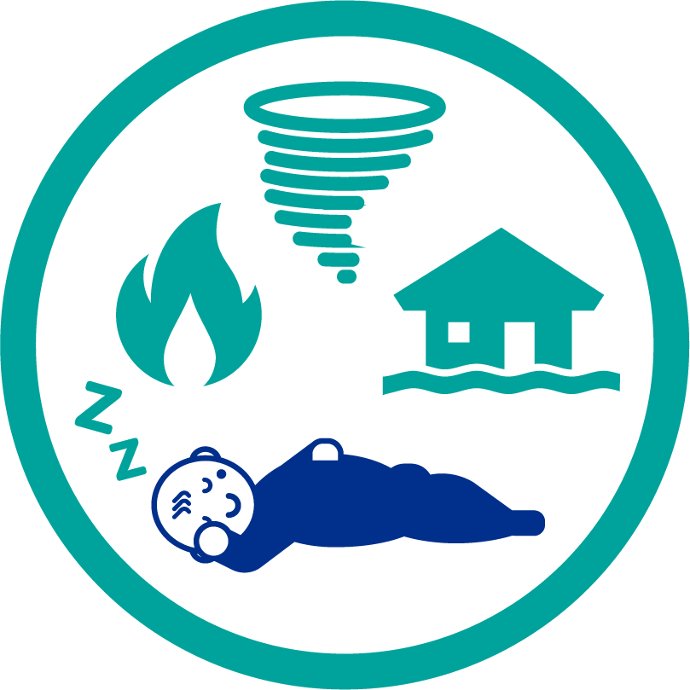

Let’s Talk - Special Topics
Sleep Training
Emergencies
Special Health Conditions
Notes:
Other information that can impact you and other infant caregiver’s use of safe infant sleep practices include:
Sleep Training
The term "sleep training" is often used to mean any information that parents use to get their baby to sleep longer at night.​
Many sleep training programs and methods can be found online, but not all follow safe sleep guidelines.​
Putting infants to sleep in a separate room for sleep training may be linked to an increased risk of SIDS.
Emergencies
Have a safe sleep plan in place just in case you must leave your home during an emergency.​
Natural disasters, like tornadoes, hurricanes, floods, and fires can happen quickly and be scary. Have a plan to keep your baby sleeping safely.​
Special Health Conditions
Babies who are born early (premature) or who have special health conditions (illness or disease) may be at a higher risk for SIDS.​
Making a safe sleep plan before you leave the hospital can help keep your baby safe.​
(Source for information – AAP Recommendations and NCEMCH and NAPPSS Building on Campaigns with Conversations Training)

Slide 53
What Challenges Do I Have?
Which of the actions that we discussed may be hard for me?
Do I need more information about how to keep my baby safe during sleep?
Do all my baby's caregivers understand how to keep my baby safe during sleep?
Notes:
Ask parents and caregivers to consider:
Which of the actions that we discussed may be hard for me?
Do I need more information about how to keep my baby safe during sleep?
Do all of my baby's caregivers understand how to keep my baby safe during sleep?
Providing a safe and respectful space and educators can facilitate discussion among participants about each question.

Slide 54

How Can I Plan for Safe Infant Sleep?
Notes:
Image credit: Texas DSHS

Slide 55
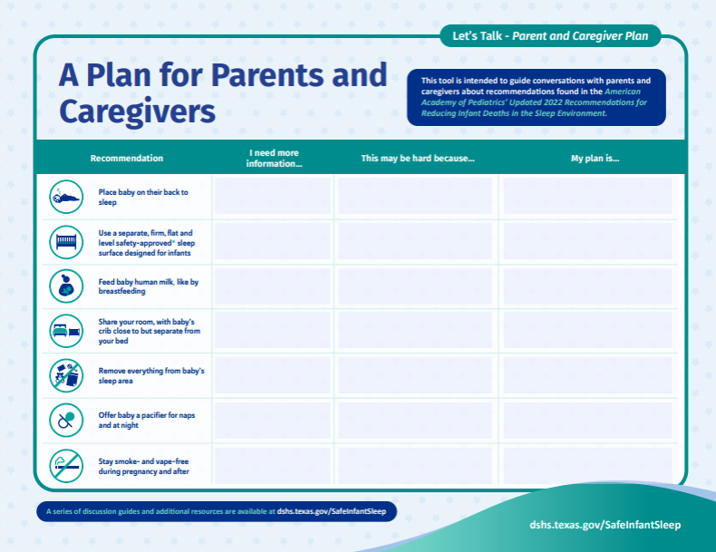
Creating a Safe Sleep Plan
Where will my baby sleep at home?
Where will my baby sleep when staying with other caregivers (grandparents, aunts, uncles, babysitters, etc.)?
Where will I feed my baby at night?
How will I handle feeding my baby at night when I am sleepy?
What will I do if I fall asleep while feeding my baby?
Notes:
Ask participants to locate the Let’s Talk- Plan for Parents and Caregiver handout pictured on the slide.​
Ask participants to consider the recommendations and to take a few minutes to identify:
-Which of the actions we discussed may be hard for me?
-Do I need more information about how to keep my baby safe during sleep?
-Do all of my baby's caregivers understand how to keep my baby safe during sleep?
Circulate the room to support parents and caregivers.
Reference:
Bronheim, S. (2017). Building on campaigns with conversations: An individualized approach to helping families embrace safe sleep and breastfeeding. Washington, DC: National Center for Education in Maternal and Child Health.

Slide 56

When Can a Plan Be Helpful?
Plan for the known or unknown to keep your baby safe:
  While traveling​.
  When you have to leave your home like during an emergency or natural disaster).
  When someone other than you will be caring for your baby like a family member or child care provider.
  If you leave your home quickly, like in an emergency.
Notes:
Planning for the known or unknown care support safe sleep for babies.​
While traveling​
When displaced from the home (e.g., during an emergency or natural disaster)​
When someone other than you will be caring for your baby (e.g., family member or child care provider)​
If you leave your home due to an emergency
Examples of non-usual care providers: day care provider, family member, babysitter or friend​
​
Babies who are used to sleeping on their back are at greater risk of unexpected death when placed on their tummies to sleep.
Image credit: Texas DSHS

Slide 57

Who Can Help Me?
Plan for Safe Sleep
Notes:
Image credit: Texas DSHS

Slide 58
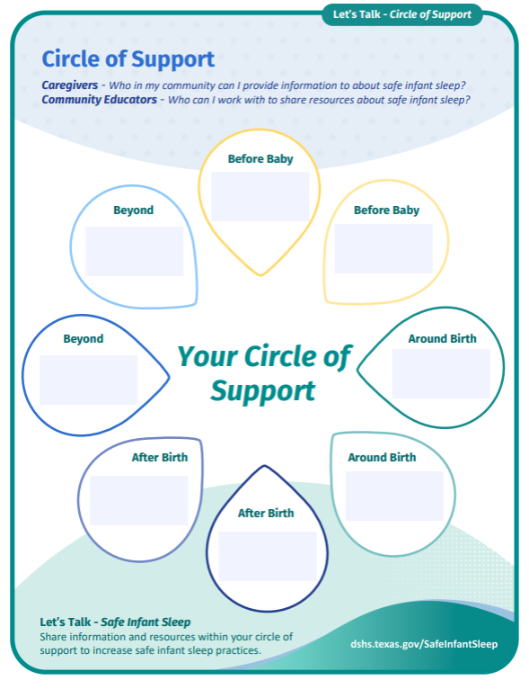
Circle of Support
Before your baby is born
Around the time your baby is born
After your baby is born
Beyond
Notes:
Ask participants to locate the Let’s Talk- Circle of Support handout pictured on the slide.
Do you remember the challenges we discussed earlier?
Each of you may experience your own challenges to adopting the safe infant sleep practices. Sometimes we may need help. You can find help here in our community before birth, around birth, after birth , and beyond that time.
Let’s work together to think of who your circle of support might be?
Does anyone know who they can go to before birth? What type of help could they provide?
How about at birth- who in the hospital could talk to if you have questions? Let’s imagine you need to find a doctor to provide your baby check-ups, who could you ask?
After birth and you are home who could you call? How about if you are having a hard time breastfeeding?
Now beyond that early time in your baby’s life, who can you connect with in your community to support you?

Slide 59
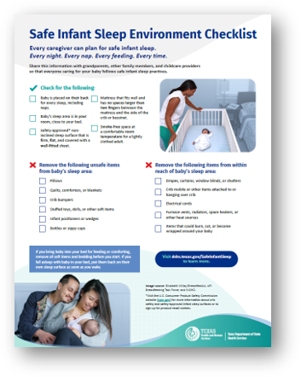
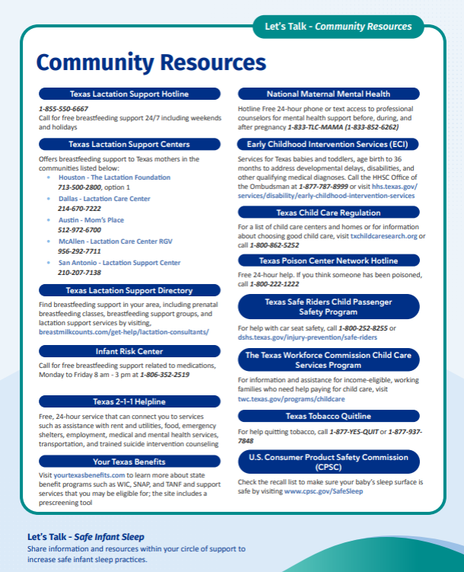
Community Resources
Notes:
Ask participants to locate the Let’s Talk- Community Resource and Safe Infant Sleep Environment Checklist handouts pictured on the slide.
Share that their Circle of Support along with organizations found on the community resources handout can help support their goals safe sleep for their baby.

Slide 60
Safe Infant Sleep
Every caregiver can plan for safe infant sleep.
Every night. Every nap. Every feeding. Every time.
DSHS Safe Infant Sleep Website:
dshs.Texas.gov/SafeInfantSleep
dshs.texas.gov/SuenoInfantilSeguro
For questions, email us at: InfantHealth@dshs.Texas.gov
Notes:
We would like to share that we just launched our Safe Infant Sleep webpage for parents and caregivers to learn more about safe infant sleep recommendations. Current information is based on adaptations of the national Safe to Sleep ® campaign materials (like the safe sleep environment PDF mentioned in the previous slide), but more resources and information are being developed as we speak and made available on this site throughout the year.
As our tagline indicates, this information is not just for parents. We encourage you to bookmark our site and share with everyone who cares for an infant, so they can better understand the importance of practicing safe infant sleep.
Information source: Eunice Kennedy Shriver National Institute of Child Health and Human Development Safe to Sleep campaign: https://safetosleep.nichd.nih.gov/

Slide 61
References
Images courtesy of:
  DSHS Maternal Child Health Unit Safe Infant Sleep campaign;
  iStock photo purchased for unlimited use by DSHS Tobacco Prevention and Control;
  Safe to Sleep® campaign, for educational purposes only; Eunice Kennedy Shriver National Institute of Child Health and Human Development, http://www.nichd.nih.gov/sids;
  United States Breastfeeding Committee; and
  Link to collective Let’s Talk Safe Infant Sleep Toolkit reference page

